Slide 1
CRAFTING COMPELLING WEB PRESENCES
PROJECT
Presented by
AjithKumar R

Slide 2

BAJAJ FINANCE LTD
https://www.bajajfinserv.in/

Slide 3



The Three Main services that provided by Bajaj Finance
Bajaj Finserv's EMI Finance service allows customers to purchase a wide range of products on easy monthly instalments, making expensive purchases more affordable. Whether it's buying electronics, home appliances, or furniture, customers can enjoy the convenience of spreading the cost over manageable EMIs with attractive repayment terms and minimal down payment requirements.
1.EMI FINANCE
Bajaj Finserv provides hassle-free personal loans designed to address various financial needs, whether it's funding a wedding, planning a vacation, or covering medical expenses. With competitive interest rates, flexible repayment options, and quick disbursal, their personal loans offer financial assistance with minimal paperwork and convenient online application processes.
2.PERSONAL LOANS
Bajaj Finserv offers comprehensive health insurance plans to safeguard individuals and families against unforeseen medical expenses. Their health insurance policies provide coverage for hospitalization, medical treatments, diagnostic tests, and more, ensuring financial protection during times of illness or emergencies. With options for cashless claim settlements and extensive network hospitals, Bajaj Finserv's health insurance plans offer peace of mind and security for healthcare needs.
3.HEALTH INSURANCE

Slide 4
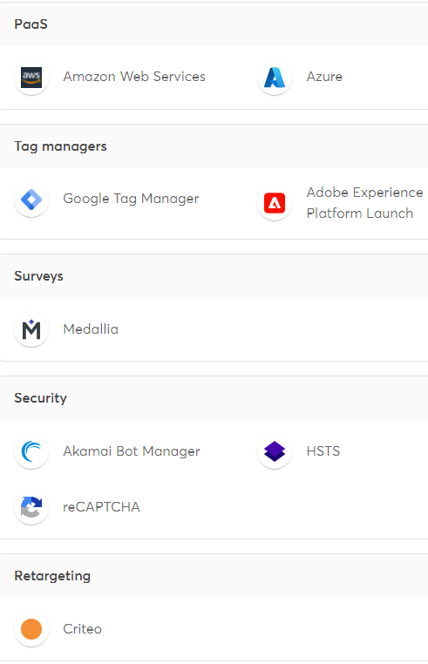
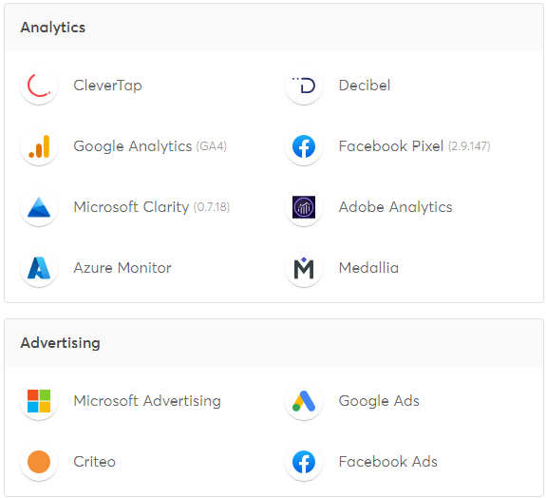

https://www.bajajfinserv.in/ The website is developed by the platforms
PROGRAMMING
LANGUAGE

Slide 5
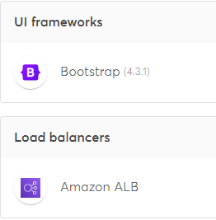
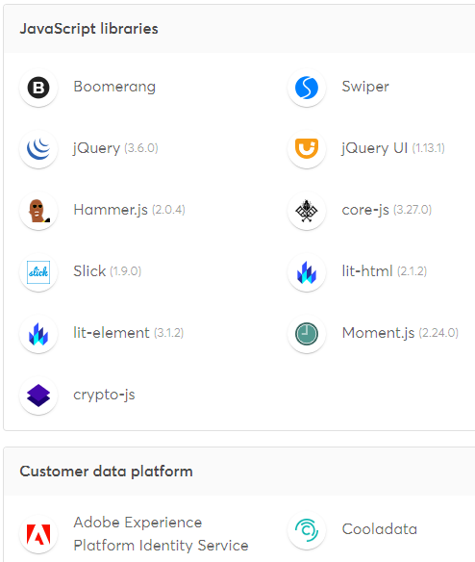
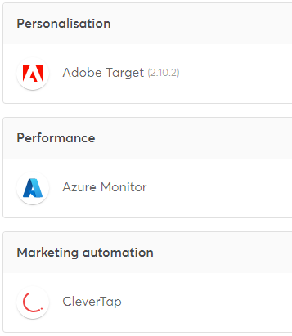
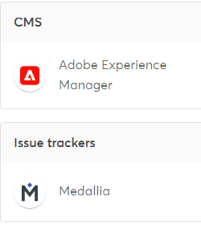
https://www.bajajfinserv.in/ The website is developed by the platforms

Slide 6
https://www.bajajfinserv.in/ website's responsive design and mobile optimization
HOME PAGE
TEST SIZE | RESPONSIVE QUALITY
320 x 568 (IPHONE 5) | NOT GOOD
375 X 667 (IPHONE 6) | NOT GOOD
1024 X 769 (IPAD) | GOOD
1440 X 900 (LAPTOP) | GOOD
1680 X 1050(DESKTOP) | GOOD
2560 * 1449 (DESKTOP) | GOOD
HELP & SUPPORT PAGE
TEST SIZE | RESPONSIVE QUALITY
320 x 568 (IPHONE 5) | GOOD
375 X 667 (IPHONE 6) | GOOD
1024 X 769 (IPAD) | GOOD
1440 X 900 (LAPTOP) | GOOD
1680 X 1050(DESKTOP) | GOOD
2560 * 1449 (DESKTOP) | GOOD
PAYMENT PAGE
TEST SIZE | RESPONSIVE QUALITY
320 x 568 (IPHONE 5) | GOOD
375 X 667 (IPHONE 6) | GOOD
1024 X 769 (IPAD) | GOOD
1440 X 900 (LAPTOP) | GOOD
1680 X 1050(DESKTOP) | GOOD
2560 * 1449 (DESKTOP) | GOOD
INSURANCE PAGE
TEST SIZE | RESPONSIVE QUALITY
320 x 568 (IPHONE 5) | GOOD
375 X 667 (IPHONE 6) | GOOD
1024 X 769 (IPAD) | GOOD
1440 X 900 (LAPTOP) | GOOD
1680 X 1050(DESKTOP) | GOOD
2560 * 1449 (DESKTOP) | GOOD
PERSONAL LOAN PAGE
TEST SIZE | RESPONSIVE QUALITY
320 x 568 (IPHONE 5) | GOOD
375 X 667 (IPHONE 6) | GOOD
1024 X 769 (IPAD) | GOOD
1440 X 900 (LAPTOP) | GOOD
1680 X 1050(DESKTOP) | GOOD
2560 * 1449 (DESKTOP) | GOOD

Slide 7
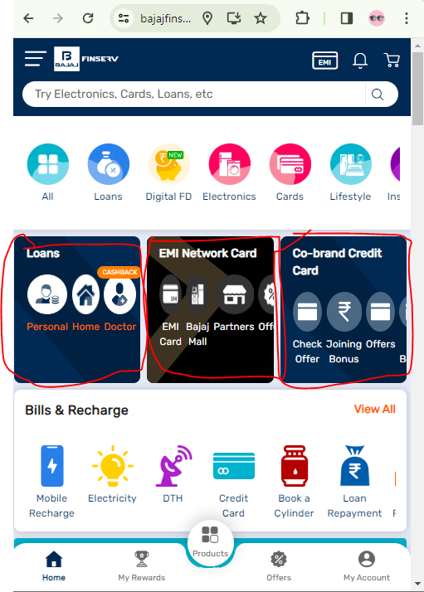
website's responsive design and mobile optimization
https://www.bajajfinserv.in/
Design of the Banner not displayed and not aligned properly in 357 x 667 iPhone 6 screen view
357 x 667 – iphone view----→

Slide 8
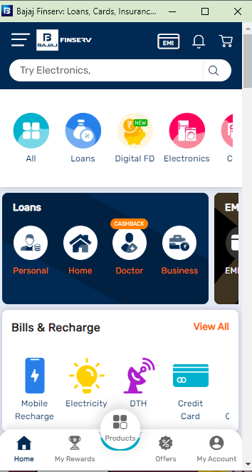
https://www.bajajfinserv.in/ website's responsive design and mobile optimization
An carousel Navigation Arrow Bar can be added for better display of banners and Users can know easily about all the services available in the side bars
SAMPLE PAGE- iPhone 13 Mini

Slide 9
ALMOST ALL THE PAGES AND LAYOUTS ARE LOOKING GOOD
https://www.bajajfinserv.in/
Top 5 suggestions to Identify common website design mistakes to avoid, such as cluttered layouts and slow loading times.
1. Keep your layout clean and organized to avoid overwhelming visitors.
2. Optimize loading times by reducing image sizes and minimizing HTTP requests.
3. Ensure easy navigation with clear menus and intuitive design.
4. Make sure your website is mobile-friendly for users on all devices.
5. Maintain consistent branding throughout your site for trust and recognition.

Slide 10
List of best practices for creating visually appealing and user-friendly website designs.
Keep it Simple and Clean
A clutter-free layout makes everything easier to find.
Stay True to Your Brand
Consistent colours, fonts, and images help reinforce your brand identity.
Think Mobile First
Make sure your site looks good and works well on phones and tablets.
Speed Matters
Optimize images and other content to keep loading times snappy.
Easy Navigation
Help people get around with user-friendly menus and search options.
Visual Appeal
Use high-quality visuals to grab attention and enhance the user experience.
Readable Typography
Choose easy-to-read fonts and give them some space to breathe.
Embrace Whitespace
Whitespace helps improve readability and highlight important content.

Slide 11
List of best practices for creating visually appealing and user-friendly website designs.
Accessibility for All
Ensure your site is accessible to everyone, regardless of disabilities.
User-Centric Design
Design with your users in mind to meet their needs and preferences.
Clear Call-to-Actions
Guide users towards desired actions with prominent buttons and links.
Consistent Layout
Maintain consistency across your site for a cohesive user experience.
Provide Feedback
Give feedback when users interact with your site to guide them along the way.
Cross-Browser Compatibility
Test your site on different browsers to ensure it looks good everywhere.
Continuous Improvement
Keep tweaking and improving based on user feedback and behaviour to enhance the overall experience.

Slide 12
I’VE CREATED A LANDING PAGE FOR BAJAJ FIXED DEPOSIT
LINK:
http://akinsights.unaux.com/landing-page-project/

Slide 13
THANK YOU

